Slide 1
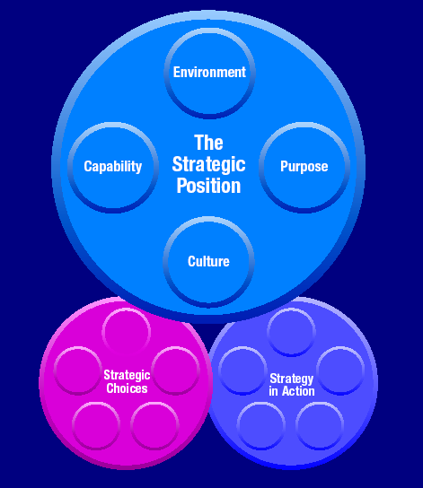
DRUGI DIO
Strategijsko pozicioniranje-
Vanjsko okruženje org.
19-10-2017

Slide 2
Fokus i ključna pitanja
Kako analizitrati poziciju org u kontekstu vanjskog okruženja?
Kako analizirati i utvrditi detreminante strategijskih sposobnosti?
Kako razumjeti namjere org uzimajući u obzor korporativno upravljanje, očekivanja interesnih grupa i poslovnu etiku?
Kako adresirati važnost tradicije i kulture poslovanja u određivanju pozicije org.?

Slide 3
Očekivani rezulatati predavanja (1)
Razumijevanje generalnog makro okruženja u pogledu politike, ekonomije, društva, prirodene sredine, tehnologije i zakonodavstava.
Razumijevanje i mogućnost identifikacije ključnih pokretača i makroekonomskom okruženju u njihovu upotrebu u odoređivanju alternativnog scenarija u slučaju promjena u okruženju.

Slide 4
Slojevi poslovnog okruženja
The macro-environment
Industry (or sector)
Competitors
The
Organisation

Slide 5
The Macro-Environment
PESTEL
Key
drivers
Scenarios

Slide 6
PESTEL Okvir za analizu makro-okruzenja
Political
Economic
Social
Technological
Environmental
Legal

Slide 7
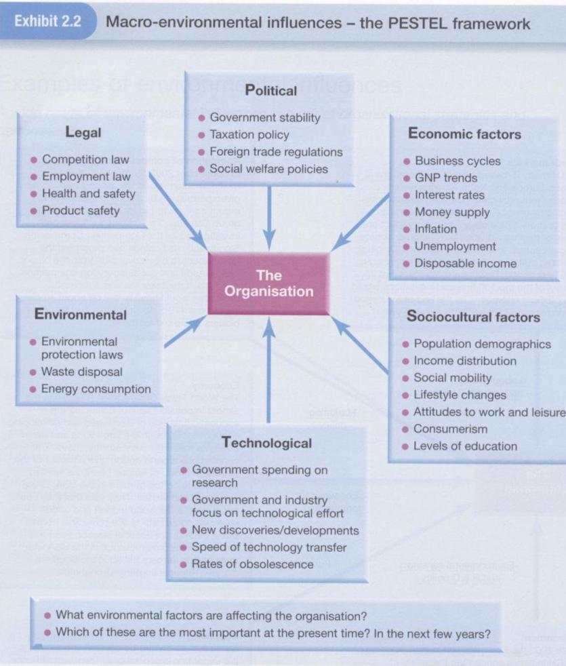
Source: Johnson, Scholes &Whittington, 2006:68
Notes:
Loosing (innovative) value (obsolescence)

Slide 8
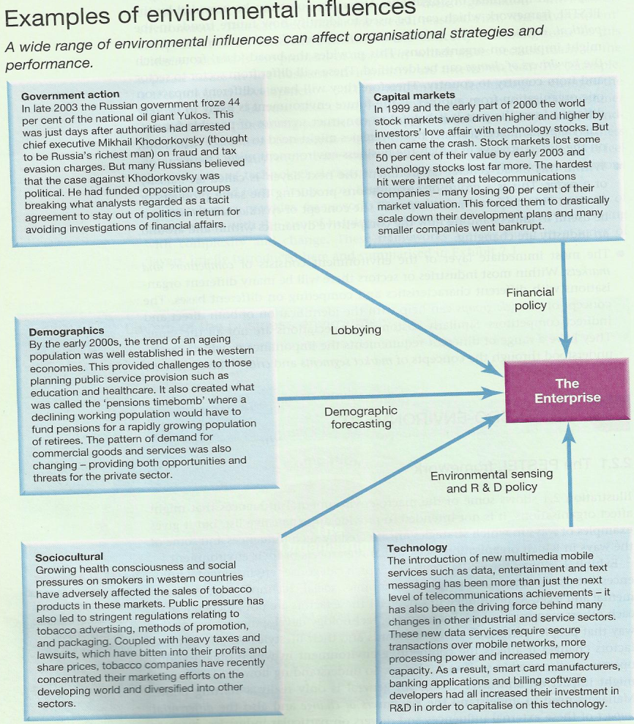

Slide 9
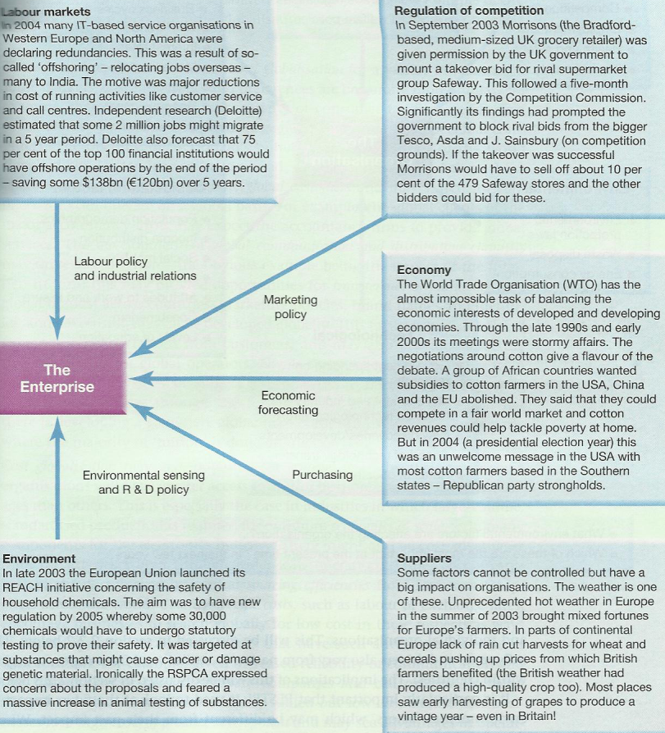
Notes:
REACH is the European Community Regulation on chemicals and their safe use (EC 1907/2006). It deals with the Registration, Evaluation, Authorisation and Restriction of Chemical substances. The law entered into force on 1 June 2007.
Royal Society for the Prevention of Cruelty to Animals

Slide 10
Nešto više o makro-okruženju

Slide 11
Levels of analysis
Microeconomic analysis – concerned with the study of economic decision taking by both individuals and firms
Macroeconomic analysis – concerned with the study of economic decision as a whole (i.e. with economic aggregates)
Macroeconomics recognise the interdependent nature of markets, and studies interaction in the economy ---- level of employment, the rate of inflation, the % of growth of output in the economy etc.
The macro environment is closely linked to the general business cycle, as opposed to the performance of an individual business sector.

Slide 12
The flows of the economic activity
Economic activity can be seen as a flow of economic resources into firms which produce output for consumers and the corresponding flows of payment (see Figure 1)
The flows of resources, production, income and expenditure represent fundamental activities of an economy (describing the real flows)
The consumption gives rise to the flow of expenditure representing an income for firms which they use to purches resources… flow of income and expenditure is shown in Figure 2

Slide 13
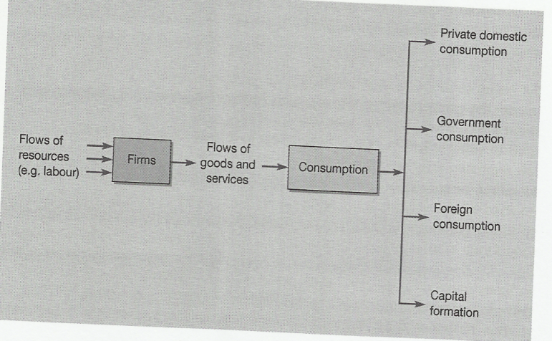
The flows of the economic activity

Slide 14
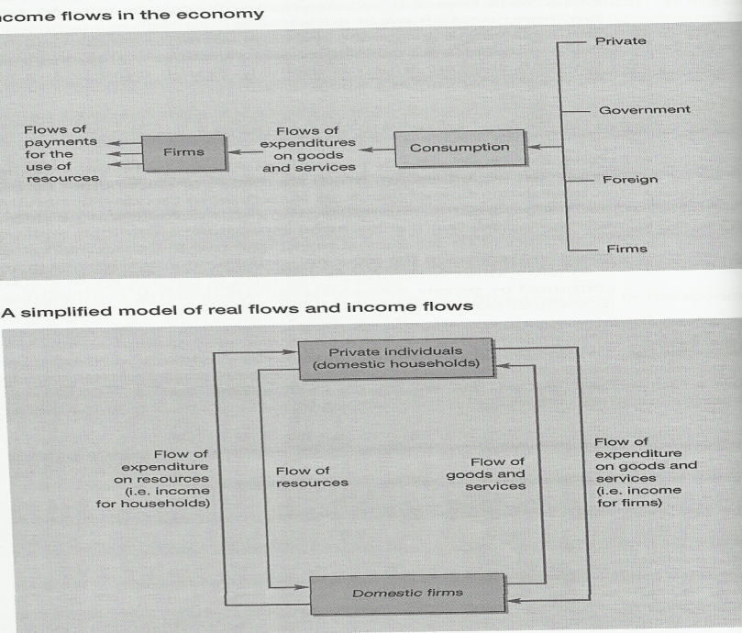

Slide 15
Model of real economy and income flow: an analytical tool
Firms success is connected with the spending decision of households
Level of spending have repercussion at both micro and macro level
During recessions consumption level declines that may be influenced by high interest rates, debt growth due to previous spending, decline for markets abroad…
Some businesses survive recession yet many go out from it resulting declines in economic output, unemployment grow, investment decline, house prices fall…
Recovery is back with increase of consumer confidence (the key link between consumption and entrepreneurial activity)

Slide 16
Changing in economic activity (Figures 3 and 4)
The level of spending by consumers is influenced by many factors (i.e. income tax reducing the income to spend…plus more saving, and buying preference –domestic vs. imported products/services), thus reducing the income of domestic firms…
This creates leakages (withdrawal) from the circular flow of income (explaining business revenue fluctuation)
Part of leakages may go to the economy to stimulate domestic firms (production and demand for capital goods) – investment spending (films for investment can borrow money saved by consumers)
Govt use taxation on provision of public goods (public expenditure), plus export spending- these additional forms of spending represent and injection of income into the circular flow (Figure 4)

Slide 17
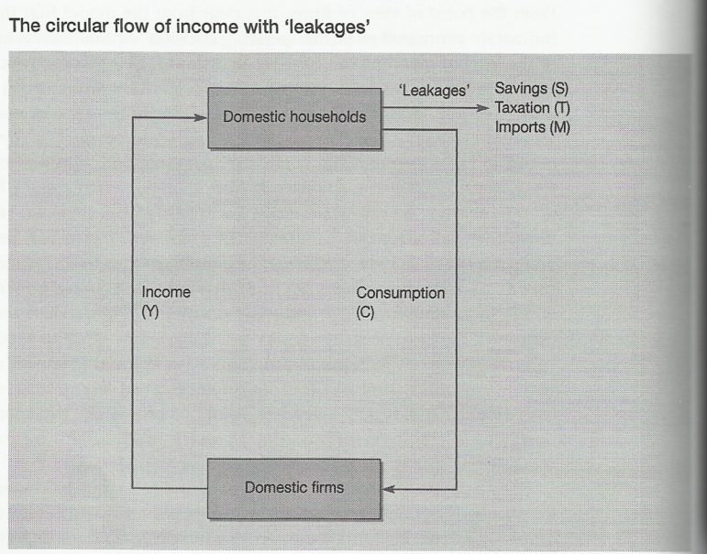

Slide 18
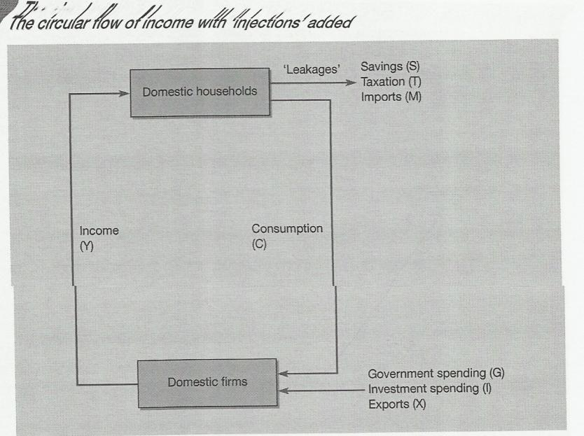

Slide 19
Government and the macroeconomy: key issues
Spending comes from consumers, firms, government and external sources – total demand in the economy for goods and services (AggregateMonetaryDemand- AMD =consumer + investment + govt spending + export spending-import spending)
Govt have critical roll on shaping demand through polices on spending and taxation or on int. rates influencing both demand and supply
Understanding choice of polices used by govt and the objectives is important to understand /analyse the business environment

Slide 20
Controlling inflation
Upwards movement of level of prices , for govt reducing this trend is a primary economic objective
monitoring trends in predicting price movement may includes:
  Retail price index – average family spending
  Examination of the underling rate of inflation (excluding mortgage)
  Measuring factory gate prices to indicate future changes in consumer prices
  Comparing domestic inflation rate with the key (country) competitors
Changes in monetary aggregates (measures amount of many –potential spending power) circulate in the economy is also a reliable guide for possible future price increases

Slide 21
Economic growth
Govt’s objectives is to achieve steady (3-4%) and sustained levels of non-inflationary growth (led by export) (real national income or GDP)
Negative growth of GDP for 2 consecutive quarters produce recession
Encouraging increased consumption of imported goods /services could be at the expense of domestic firmer (deindustrialisation)
Increase consumption on govt spending the potential gain for business may be offset by the need to increase int. rates to fund the spending

Slide 22
Reducing unemployment
Full employment is developed countries is no longer priority, but govt tend to focus on job creation and skills development to meet demands
Statistic relating to the employment/unemployment need to be used with care…
Higher unemployment may cause broader economic and social consequences (waste of resources, pressure on public services – reduction on tax yields, increase public expenditure on welfare state etc. )
Cyclical (general deficiency in demand), Structural (deficiency in demand in particular sector), and technological unemployment
Notes:
Definition of 'Structural Unemployment'
A longer-lasting form of unemployment caused by fundamental shifts in an economy. Structural unemployment occurs for a number of reasons – workers may lack the requisite job skills, or they may live far from regions where jobs are available but are unable to move there. Or they may simply be unwilling to work because existing wage levels are too low. So while jobs are available, there is a serious mismatch between what companies need and what workers can offer. Structural unemployment is exacerbated by extraneous factors such as technology, competition and government policy.

Slide 23
A favourable balance of payment
BoP the net balance of credit (earnings) and debits (payments) arising from international trade in a given period of time
Govt prefer to have either equilibrium or payment surplus
BoP on current account (imports and exports of goods/services) is an important indicator of competiveness (economy, firms, industry)
Sustain Current account deficit indicates structural problems in particular sector or its economy or possibility of exchange rate which favourites import
Notes:
платни биланс se дефинише као системски двострани преглед (попис) СВИХ економских трансакција обављених између резидената и нерезидената у одређеном временском периоду - најчешће у једној години. Дакле, у платни биланс бележе се и ефективно извршена плаћања у току године али и она плаћања која се одлажу за касније (на кредит).

Slide 24
Controlling public borrowing
Govt raise large amounts of revenue trough taxation (surplus and deficit of the budget)
Govt often face budget deficit therefore have a public sector borrowing requirements (sign of an economy difficulties)
high level of public borrowing tends to have impact on:
  Interest rates (high interest rates –impact on consumption and investment)
  Opportunity costs of debt interest particularly other forms of public spending
  General lack of confidence in the market about govt ability to control the economy
  convergence criteria laid down at Maastricht to entry to Euro zone (govt debt no higher then 3% of GDP

Slide 25
Govt and the macro-economy: polices
Key roles in the economy:
  Consumer or resources (e.g. employer, landowner)
  Supplier of resources (e.g. infrastructure, information)
  Consumer of goods and services (govt spending)
  Supplier of goods and services (e.g. nationalised industries)
  Regulator of business activity (e.g. fiscal and monetary policy),
  Redistributors of income and wealth (e.g. taxation system)

Slide 26
Fiscal policy
Involves the use of change in govt spending and taxation and influence the level of consumption of aggregate demand of in the economy
Important implication for businesses, such as:
  Reduction in taxation will inject additional income into the economy, or
  opposite effect, depressing business prospects, discouraging investment and causing rise in unemployment
Reduction of taxes can be used to encourage business and investment…
See Figures (5 and 6)for govt revenues and spending

Slide 27
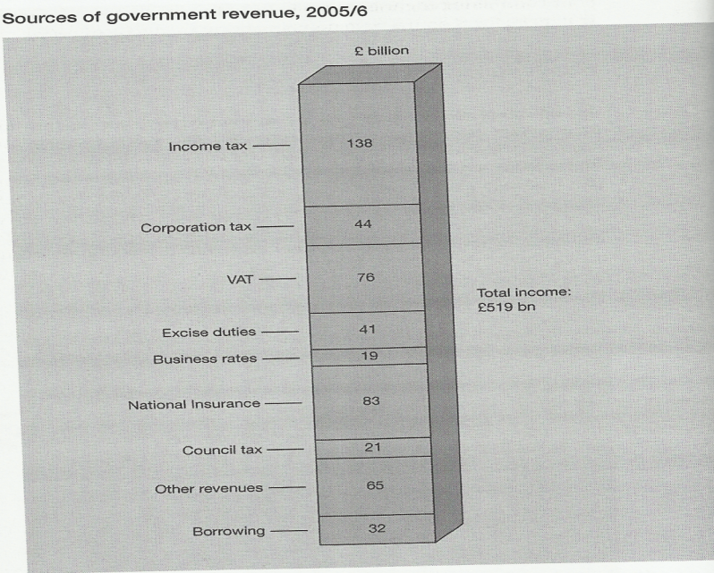

Slide 28
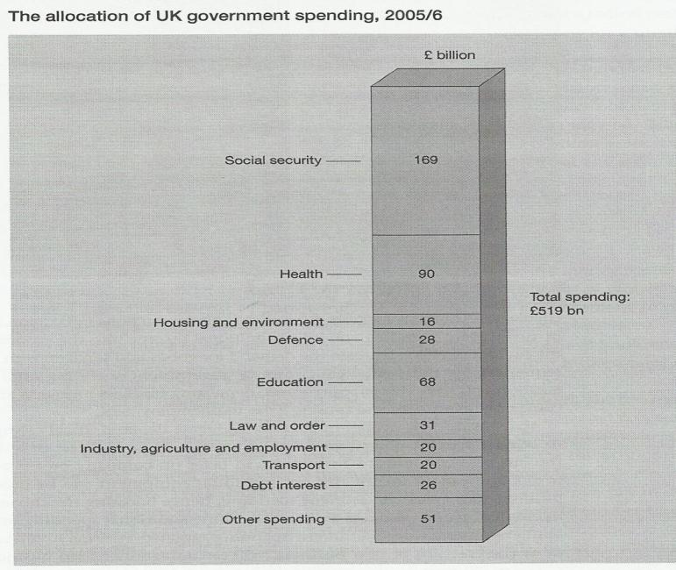

Slide 29
Monetary policy
It influences monetary variables – money supply or rates of interest in order regulate the economy
Interest rates manipulation has a number implications in the economy
Changing in the money stock (credit in particular) affect the capacity of individuals and firms to borrow / spending
Oversupply of money tends to create inflationary pressure and to increase spending on import

Slide 30
The role of financial institutions
Interaction in the macro economy (govt, businesses, consumers) take place within institutional environment includes numerous financial intermediaries
Elements of the financial system
  Lenders and borrowers
  Financial institutions
  Financial markets (transfer of many and other type of asset including papers assets such as shares and stock
Financial markets includes the markets for short-term funds (money markets), long term finance for both private and public (capital market)- stock exchange is central part of it
Financial intermediaries play vital role in the operation of the financial system (see Figure 7)

Slide 31
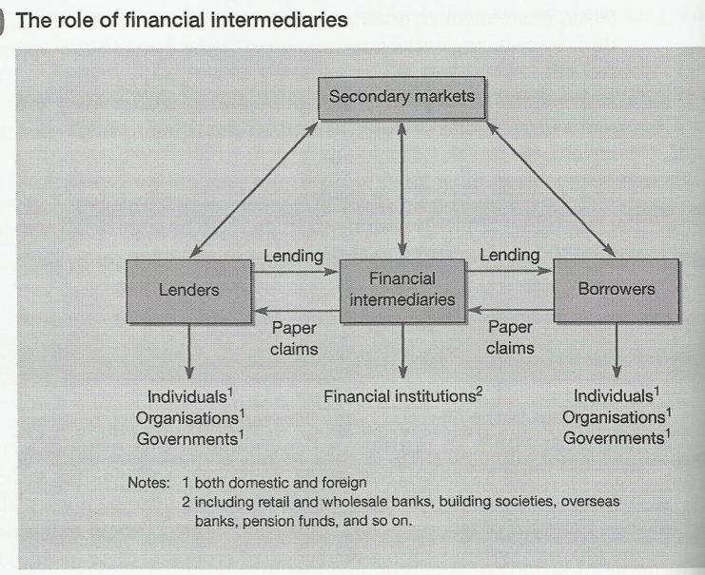

Slide 32
International economic institutions and organisations
IMF – 1946 (Bretton Woods conference to govern the global finance to avoid another depression that triggered the WWII), 184 members
It was to provide a pool of foreign currencies from its member states use to facilitate trade imbalance between countries…promoting structural growth, boosts international trading environment, encouraging exchange rate stabilities…
Most recent objectives to switch towards international surveillance and helping developing economics with monitoring debt problems, and assisting with reconstruction

Slide 33
Cont..ed
EBRD- 1991 to facilitate the transformation of the staes of CEE (transition)…privatisation process, technical assistance, training and investment in upgrading of infrastructure…
The World Bank (IBRD)- 1945 know as intr. bank for reconstruction and development as a specialised agency of the UN set up to encourage economic growth in dev. Countries (provision of loans and technical assistance), 180 members
The European Investment Bank (EIB) – 1958 at the Treaty of Rome to finance institution of EU to
  Contribute to the integration, balance development and the economic and social cohesion

Slide 34
Ključni pokretači promjena
Ograničenost PESTLE koncepta
Važnost identifikacije ključnih pokretača
Globalizacija tržišta (globalni potrošač)
Cijena globalizacije (mogućnost sticanja konkurentne prednosti – ekonomja obima, dobavljači, specifičnosti države, cijena razvoja proizvoda…)

Slide 35
Ključni pokretači promjena poslovnog okruženja
kljični pokretači promjena su oni faktori poslovnog okruženja koji imaju veliki uticaj na uspjeh i neuspjeh org. ili njene stratgije.

Slide 36
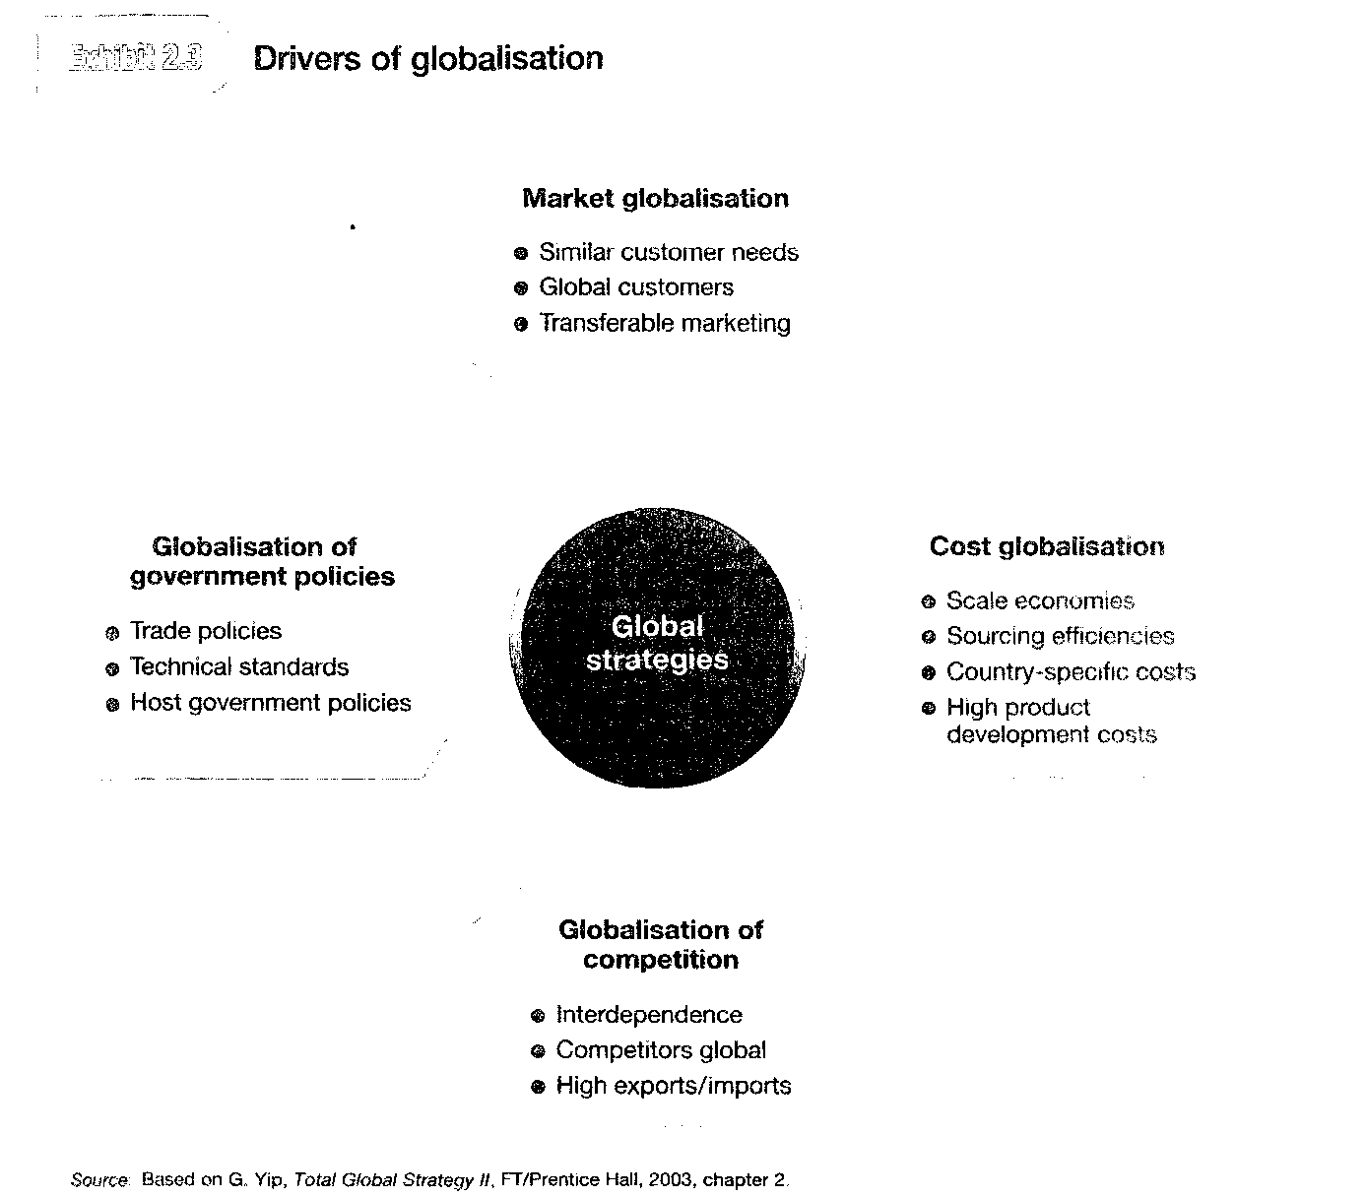

Slide 37
Neizvjesnost p.okruženja i planiranje/izrada scenarija
Scenario je detaljni i vjerodostojni pogled na pravce mogućih promjena biznis okruženja rukovodeći se ključnim pokretačima promjena pri čemu se mora voditi računa o visokom nivou neizvjesnosti.
Primjer: energija, mediji, izdavačke kuće (budućnost?)

Slide 38
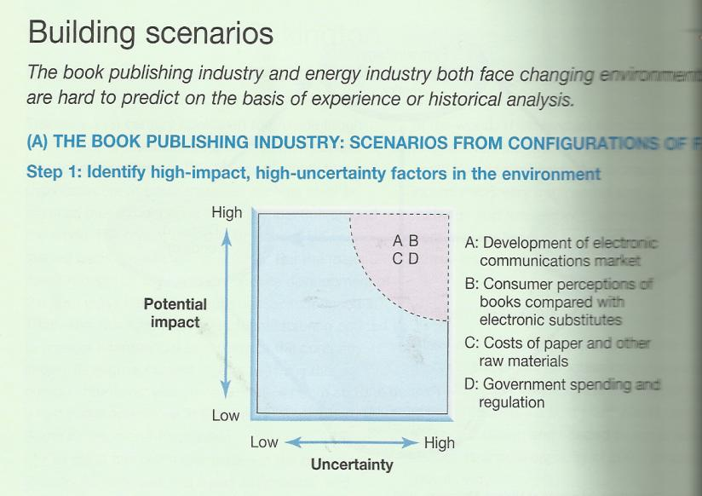
A (brze promjene, mjerljive promjene); B (povoljno, nepovoljno); C (visok i u porastu, stabilizirajući); D (u korist tradicionalniog- knjiga, u korist e-medija)

Slide 39
Primjer izdavačke industrije,
Izdavanje knjiga
Korak 1.
Ident. visoke uticaj i faktore u p.okruž
a) Razvoj tržišta za e-komunikaciju
b) Percepcija potrošača o konvencionalnim knjigama u odnosu na e-medije (substituti)
c) Troškovi papira i drugih sirovina
d) Troškovi javne admin (vlada) i regulative

Slide 40
...nastavak
Korak 2.
  Ident. mogućih pravaca (budućih) ovih faktora
  ( a. Brze i mjerljive promjene; b. Povoljne, nepovoljno; c. Visok i rastući, stabilan; d. Podržati knjige, podrzati e-medije)
Korak 3. konstrukcija scenaria na bazi validne konfiguracije faktora
Scenario 1. nema većih promjena: b. Povoljna, kon. Knjige podržane od strane vlade (potrošnje i regulative; d. Mjerljive promjene e-tržišta; a. Stabilni troškovi papira i dr. sirovina.
Scenario 2. elektronski haos: sve skoro suprotno predhodnom
Scenario 3. informacijsko društvo
a. Stabilno tržište konv. knjiga poredeći sa e-tržištem, b. Mjerljive promjene razvoja e-tržišta, a. i validni troškovi iregulative u podržavanju kon. Medija (d). Ali. Mogući rast troškova papira i dr. Sir. (c.).

Slide 41
29.10.2017

Slide 42
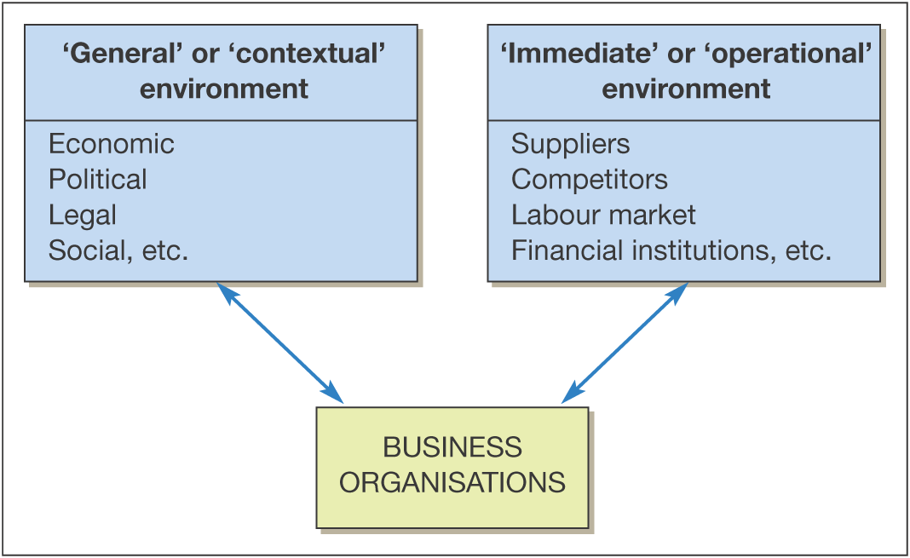
Two levels of environment
Source: Worthington & Britton, 2007:6

Slide 43
Macro-environmental analysis
Scanning macro-environments for warning signs and possible environmental changes that will effect business
Monitoring environments for specific trends and patterns
Forecasting future directions of environmental changes
Assessing current and future trends in terms of the effects such changes would have on the organisation

Slide 44
From Environment Analysis to Industry Analysis
The national/ international economy
The natural environment
THE INDUSTRY
ENVIRONMENT
Suppliers
Competitors
Customers
Demographic structure
Technology
Government
& Politics
Social structure
The Industry Environment lies at the core of the Macro Environment.
The Macro Environment impacts the firm through its effect on the Industry Environment.
Notes:
3

Slide 45
Objectives of Industry Analysis
To understand how industry structure drives competition, which determines the level of industry profitability.
To assess industry attractiveness
To identify opportunities to change industry structure to impose industry profitability
To identify Key Success Factors
Notes:
2
18

Slide 46
Forces Affecting Competition
Positioning
  Takes the structure of industry as given and matches company’s strengths & weaknesses to it
Influencing The Balance
  Devise a strategy to adjust rather than cope with competitive forces;
Exploiting Change
  Matching industry evolution with changes in structure;
Diversification Strategy
  Moving into a sector before the competition;
Source: Competitive Strategy, Porter, Collins Macmillan, pp29 – 33, 1980

Slide 47
Dimensions of Competitive Analysis
New Entrants or Substitutes
Companies seeking to diversify, or with skills to exploit in the industry
Industry Competition
Willing, able to overcome barriers
Strategic Group
Source: Marketing Strategy & Competitive Positioning, Hooley, Saunders & Piercy, Prentice Hall1998

Slide 48
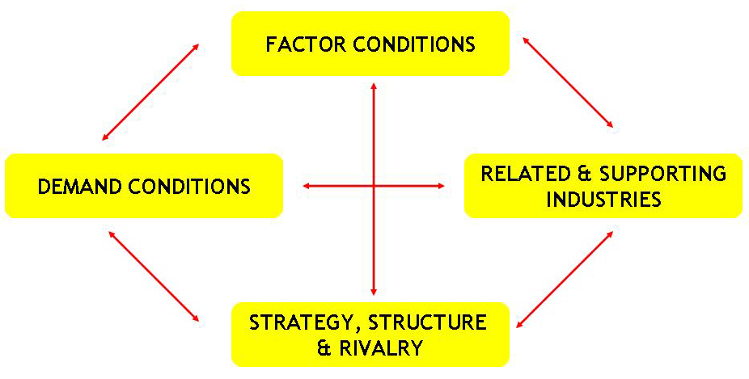
Romb konkurentnosti nacionalne ekonomije
Porter’s Diamond

Slide 49
National/Local context matters!
“Concentration is the key to economic success”. (Peter F. Drucker)
“The enduring competitive advantages in a global economy lie increasingly in local things – knowledge, relationships, motivation – that distant rivals cannot match”. (Porter)
“Correct geography is required. The right factors inputs are in de right places for the right sectors.” (World development Report)

Slide 50
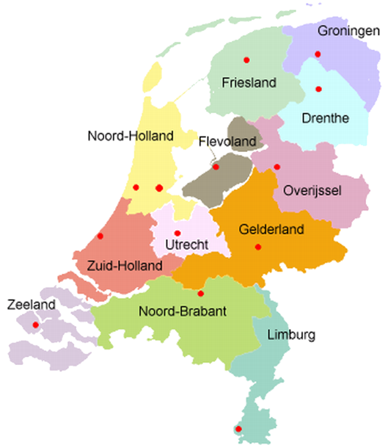
Province: a decentralized unitary state
Governance and governmental authority in the Netherlands is decentralized (= trend).
The provincial authorities are responsible for:
  environmental management,
  water management,
  Spatial planning,
  regional economic policy,
  countryside policy,
  culture.

Slide 51
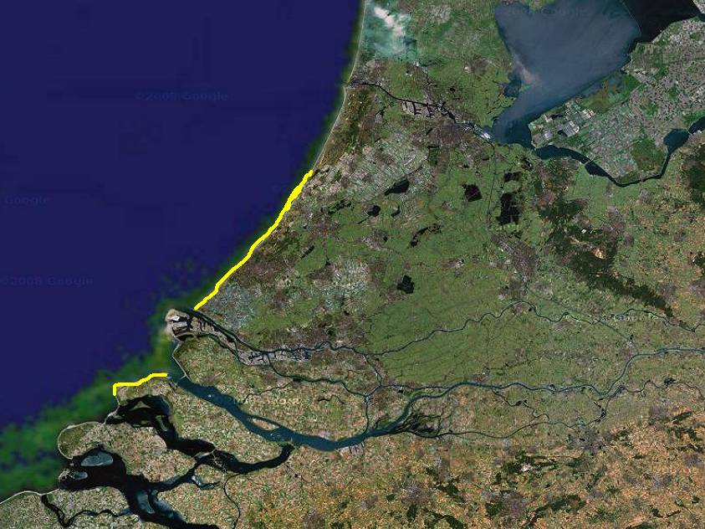

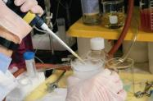
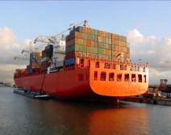
Amsterdam
Greenports
largest in the world
flowers, plants, fruits, vegetables, trees, flower bulbs
leading in technolgy for crop growing and inward processing
130.000 fte
production value: 8 billion euro/year
5300 hectares cultivated area
Schiphol Airport
Den Haag
Greenport
Brainport: knowledge axes
World class knowledge development in:
Life & Health Sciences
Space technology
Water & Delta technology
Biotechnology and Chemistry
security (The Hague Legal Capital)
Brainport
Mainport
Rotterdam
Mainport Rotterdam
Number 11 in the world, largest in Europe
150.000 fte.
Ambition to become 'Europe's industrial cluster' and 'Global Hub' while leading the field in efficiency and sustainability
Notes:
51
The province of Zuid-Holland is centrally located in Western Europe and plays a pivotting role in import and exports of raw materials and finished goods. Densely populated, highly industrious and a source of income for the Netherlands, it is not easily overlooked. Zooming in we see that Zuid-Holland is really a metropole, but a special kind. It's contains of many cities and centres and lined with nature, agricultural areas and water.
Important areas in Zuid-Hollad are <click>
Mainport Rotterdam: Europe’s largest harbour has a strong ambition to become larger, smarter and greener.
<click>
Greenports: Zuid-Holland represents 60% of the Dutch horticultural industry and is the largest in the world. The strong clustering of related businesses results in a front-runner position for innovations and knowlegde dissimation.
<click>
Brainport: The knowlegde corridor in Zuid-Holland consists of the universities of Leiden, Delft and Rotterdam, technological institutes like the Duthc Space Agency, colleges and knowlegde intensive commercial activities. Business in many clusters in Zuid-Holland interact with this knowlegde corridor leading to innovation and valorisation.

Slide 52
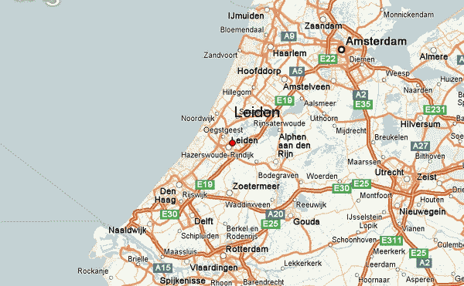
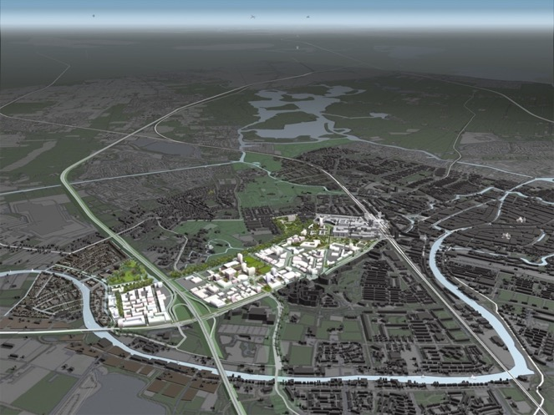
Case: Leiden BioScience Park
Leiden Bio Science Park (since 1984) leading life sciences cluster in the Netherlands.
Ranks among the top five most successful science parks in Europe.

Slide 53
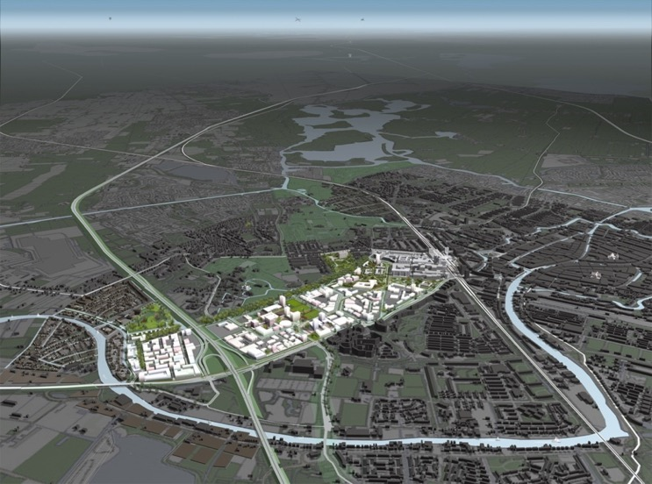
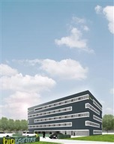


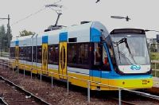


A tailer made approach
Vision – long term objectives & commitment of key stakeholders
Functional economic area.
Integrated development policy with a mix of instruments
  Infrastructure
  Education – human capital
  Promotion & acquisition
  Spatial planning
  Incubators, shared facilities
  Triple helix
  Finance: grants, revolving funds, partipatary fund
An intermediairy: LeidenBioScience Park Foundation – Reg development Organisation

Slide 54
Analiza Sektora / Grane
Važnost strateške analize sektora ili grane
Promjene nemaju isti uticaj na sve grane
Za dobru analizu grane potrebno je sagledati poslovanje uspješnih i neuspješnjih preduzeća
Granice sektora se mijenjaju (ponašanje učesnika unutar grane, nove tehnologije, inovacije)
Konkuretnst nacionalne ekonomije zavisi od promjena strukture ekonomije

Slide 55
Porterove sugestije analize sektora
Definisanje relevantne grane
Identifikacija učesnika u gani i grupisanje (strateške grupe)
Ocjena konkuretnosti (faktora- jakih i slabih)
Utvrditi opštu strukturu grane, šta utiče na profitabilnost
Analizirati skorije i buduće promjene u 5 konkurentskih sila
Identifikovati aspekte grane koji su pod uticajem postojećih i budućih konkurenata

Slide 56
Tipovi grana prema životnom ciklusu (Porter)
Nove
Zrele (više mogućih rešenja reafirmacije)
Opadajuće
  Strategijske alternative grana: žrtva, brz odlazak , liderstvo, čuvar niše)
  Šta radimo u slučaju odluke Žrtve i Brzog odlaska a šata u druga dva slučaja?

Slide 57
Veličina Grane
Zavisni od osnovnih formi strukture tržišta
3 su osnovne:
  Savršena konkurencija
  Oligopol (malo firmi kontroliše tržište- kako?)
  Monopol
Od čega zavisi stepen profitabilnosti grane?
  Okruženje nepovoljno - mnogo konkurenata, niska stopa rasta, slabe barijere ulaska, puno supstituta, visoka pregovaračka snaga...
  Povoljno gransko okruženje?

Slide 58
Cilj analize grane
Definisanje poslovne strategije preduzeća
Politika cijena
Način proizvodnje,
Inovacije
Strukturne promjene (diferencijacija proizvodnje, granske barijere...)
Dakle, cilj je iznalaženje pozicije grane za odbranu preduzeća od sila, odnosno uticati na njih

Slide 59
Porter’s Five Forces of Competition Framework
SUPPLIERS
Bargaining power of suppliers
INDUSTRY
COMPETITORS
Threat of
substitutes
POTENTIAL
ENTRANTS
Threat of
new entrants
SUBSTITUTES
Rivalry among
existing firms
Bargaining power of buyers
BUYERS
Notes:
7

Slide 60
Five Forces Analysis
The threat of entry ...
Dependent on barriers to entry such as:
  Economies of scale
  Capital requirements of entry
  Access to distribution channels
  Cost advantages independent of size (eg the “experience curve”)
  Expected retaliation
  Legislation or government action
  Differentiation
Notes:
3

Slide 61
Five Forces Analysis
Buyer power is likely to be high when:
There is a concentration of buyers
There are many small operators in the supplying industry
There are alternative sources of supply
Components or materials are a high percentage of cost to the buyer leading to “shopping around”
Switching costs are low
There is a threat of backward integration
Notes:
4

Slide 62
Five Forces Analysis
Supplier power is high when:
There is a concentration of suppliers
Switching costs are high
The supplier brand is powerful
Integration forward by the supplier is possible
Customers are fragmented and bargaining power low
Notes:
5

Slide 63
Five Forces Analysis
Threat of substitutes:
Substitutes take different forms:
  Product substitution
  Substitution of need
  Generic substitution
  Doing without
Notes:
6

Slide 64
Five Forces Analysis
Competitive Rivalry is high when:
Entry is likely
Substitutes threaten
Buyers or suppliers exercise control
Competitors are in balance
There is slow market growth
Global customers increase competition
There are high fixed costs in an industry
Markets are undifferentiated
There are high exit barriers
Notes:
7

Slide 65
NASTAVAK

Slide 66
Competitive Option 1. Integration
Mature and/or fragmented industries
  Absorbing distribution, production and selling in a trading entity
  Forward or backwards integration
Altering relationship with contractors and suppliers
Advantages
  Economies of production, internal control, market information, channel.
  Tapping into technologies, skills
  Increase in bargaining power (Forward)
  Ability to differentiate
  Defend against foreclosure

Slide 67
Option 2. Acquisitions
Hostile, Co-operative or Buy-In
Advantages for Entrepreneurial Firms
  Buying new customers, new products/production capacity, location, marketing structure, reducing cost base, acquiring skills /employees
Disadvantages
  Lack of focus caused by overconfidence, key employee loss, overvaluation, management controls, management inertia
Opportunity
  Acquire a supplier, buy-out a competitor, customer retiring, retrenchment or disinvestments
Issues
  Valuation - Assets, stock, owners equity, stock value, customer base, distribution system, staff and image
  Payback period, return on investment, cost of borrowing, availability
Alternative is a Merger/Integration

Slide 68
Option 3. Strategic Alliances
A separate entity involving two or more participants.
Private–Private, Industry-Private, NGO-Private.
Formal or informal agreement, national or international.
Alliance Check List:
  Size of project, image, trial period.
  Compatibility of partners.
  Management of responsibility.
  Symmetry between partners, expectations & dependency.
  Environmental Conditions – best in changing environments
  Timing.
  Dominance.
Includes mergers, licensing, technology transfer.

Slide 69
Option 4. Licensing
A type of strategic alliance, not always associated with high technology.
Licensing Out - cannot raise finance, export a technology, not core business.
Licensing In (integration) - alternative to direct investment, avoids R&D costs.
Assumes ownership of Intellectual Property Rights.
Issues for Licensee:
  Protection the idea, patents, registered designs, trade marks and copyrights is the main negotiating point
  Infringement of confidentiality
  Validation searches
  Legal Requirements, quality approvals,liability, market testing, design and packaging.
  Raising Funds – venture capital, angels

Slide 70
Generic Coping Strategies
Overall Cost Leadership
  Through aggressive construction of efficient-scale facilities, vigorous pursuit of cost reductions, tight cost and overhead control
Differentiation
  Creating uniqueness through design, brand technology or service
Focus
  On buyer, segments, products or geography.
Source: Competitive Strategy, Porter, Collins Macmillan, pp 34 - 41 1980

Slide 71
Five Forces Analysis: Key Questions and Implications
What are the key forces at work in the competitive environment?
Are there underlying forces driving competitive forces?
Will competitive forces change?
What are the strengths and weaknesses of competitors in relation to the competitive forces?
Can competitive strategy influence competitive forces (eg by building barriers to entry or reducing competitive rivalry)?
Notes:
8

Slide 72
Identifying Key Success Factors
Pre-requisites for successful strategy
What do customers want?
How does the firm survive competition
Analysis of competition
What drives competition?
What are the main dimensions of competition?
How intense is competition?
How can we obtain a superior competitive position?
Analysis of demand
Who are our
customers?
What do they want?
KEY SUCCESS FACTORS
Notes:
17

Slide 73
Strategic Group Analysis
A strategic group is a group of firms in an industry following the same or similar strategy.
Identifying strategic groups:
  Identify principal strategic
variables which distinguish
firms.
  Position each firm in relation
to these variables.
  Identify clusters.
Notes:
33

Slide 74
Market segmentation
Markets are rarely homogenous
Within markets there are subgroups known as market segments
This process of segmentation represents a powerful competitor tool
By identifying a specific market segment and concentration effort here firms can build a mini-monopoly

Slide 75
Bases for segmentation:develop a segmentation base
Market size
Identifiability of the segment
measurability of the segment
accessibility to the segment
Buying behavioural characteristics of the segment
The major criteria
for establishing
market segments

Slide 76
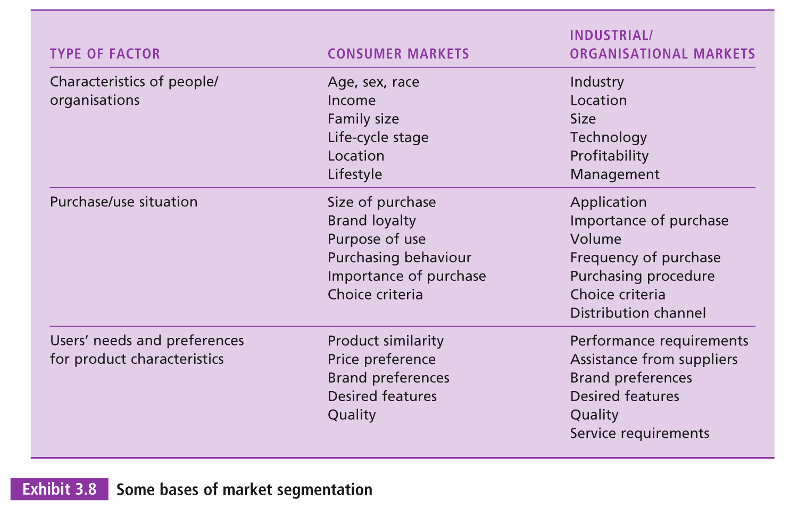

Slide 77
Steps in Segmenting Markets
1. Define the market
to be segmented
Market
Segmentation
Process
2. Select basis of segmentation
4. Analyse
segments
Source: Strategic Marketing, Craven, Irwin,1991 p164
3. Form segments

Slide 78
Segmentation
Demographic
  industry (biotech/non biotech)
  company size (B2B or B2C)
  location (rural, urban, overseas or virtual)
Operating Variables
  technology
  user status (heavy, light or non user)
  customer capabilities (many or few services)

Slide 79
Segmentation of Variables
Situational
  Seasonal
  urgency
  applications
  size of order
Personal characteristics
  buyer-seller similarity
  attitudes towards risk
  loyalty

Slide 80
Opportunities for Differentiation
Market research
Customer profiles
Forecast demand
Product development
Customer support
FAQ lists
Knowledgebase
Discussion groups
Procurement/ITTs
Marketing &
Research
Promotion &
Merchandising
After Sales
Service
Company promotion
Product information
Product pricing
Generate sales leads
Customer
Sales
Service
Product testing
Product specification
Account enquiry
Stock enquiry
Customer sales service
Product ordering
Online transaction
Direct order entry
Order tracking
Product distribution
Order
Fulfilment

Slide 81
Dynamic Competition
Porter and other frameworks assume
industry structure drives competitive behaviour and that
Industry structure is stable.
But….competition also changes industry structure
Schumpeterian Competition: A“perennial
      gale of creative destruction” where innovation overthrows established market leaders
      Hypercompetition: “intense and rapid competitive moves….creating disequilibrium through continuously creating new competitive advantages and destroying, obsoleting or neutralizing opponents’ competitive advantages
Notes:
14

Slide 82
Prijetnje od novih firmi: Barijere za ulaz na tržište
Obim i iskustvo
Pristup nabavljačima i kanali distibucije
Očekivana ‘osveta’ postojeće kompanije
Zakonodavstvo i vladine mjere
Diferencijacija

Slide 83
Zašto je substitucija (zamjena) prijetnja?
Zamjena može smanjiti potražnju za određenu vrstu proizvoda kada potrošači pređu na alternativni proizvod.
Moguće implikacije:
dodatni napori industrije
odnos cijene i performance

Slide 84
Snaga (prednost) kupaca
Postojili koncentracija kupaca?
Koji su troškovi pri promjeni nabavljača?
Dali postoji veritkalna integracija unazad?

Slide 85
Snaga nabavljača
Postojili koncetracija nabavljača?
Koji su troškovi pri promjeni nabavljača?
Dali postoji verikalna integracija unaprijed?

Slide 86
Nivo konkurentskog rivalstva
Balans konkurencije (veličina i uticaj konkurenata i želja za dominacijom)
Stopa industijkog rasta (ostvarenje raste firme kao rezultat veće potražnje ili na uštrb konkurencije)
Visoki fiksni troškovi
Visoke barijere izlaza
Mala diverzifikacija (mala diverzifikacija veće mobilnost potrošača, izbor)

Slide 87
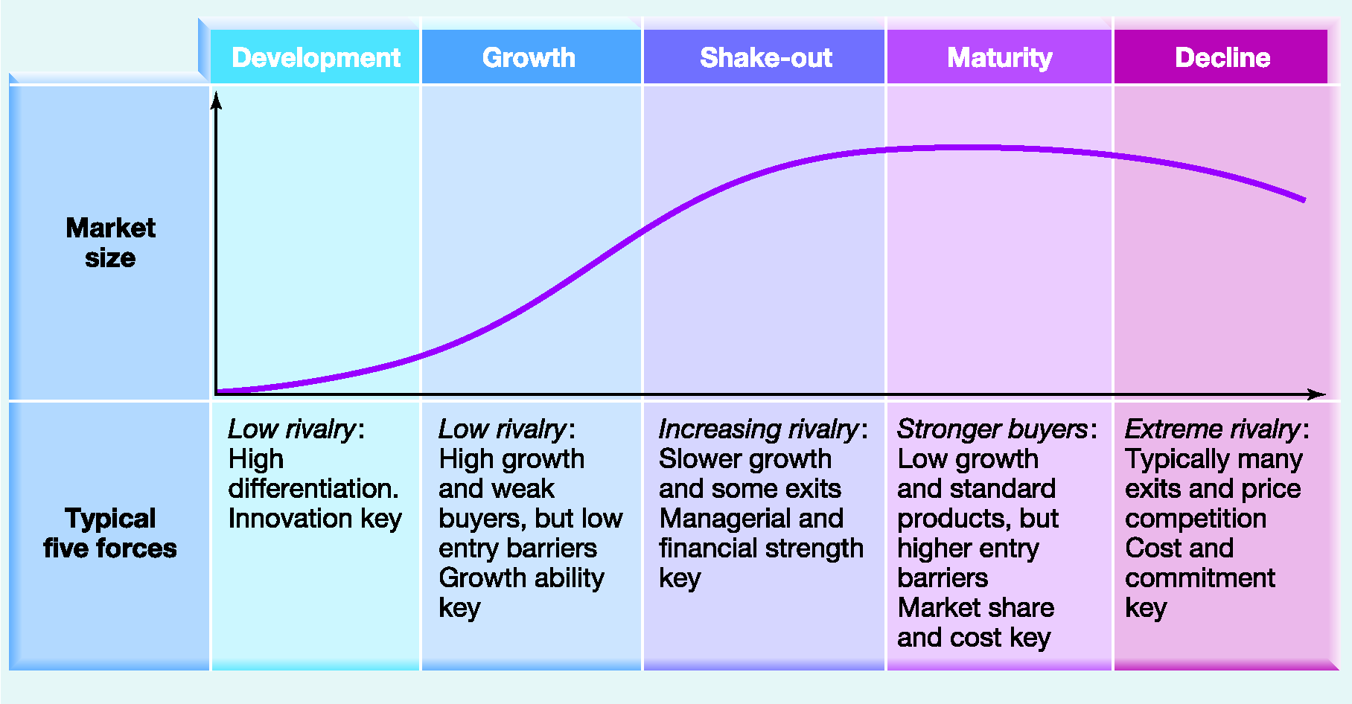
Exhibit 2.3 The Industry
Life Cycle (životni ciklus)

Slide 88
NOVEMBAR 12.

Slide 89
Menadžment Implikacije
u koju industriju da uđemo i koju da napustimo?
Koji (vlastiti) uticaj možemo iskorititi?
Šta je sa konkurencijom, dali oni imaju različite probleme i da li se ti problemi razlikuju od naših?

Slide 90
Ostali aspekti analize koncepta Pet Snaga (Porter, 1980, 1985)
Identifikovanje prave industrije
Utvrđivanje mogucnosti industrijske konverzije ili integracije
Identifikacija komplementarnih proizvoda
Notes:
Inherent

Slide 91
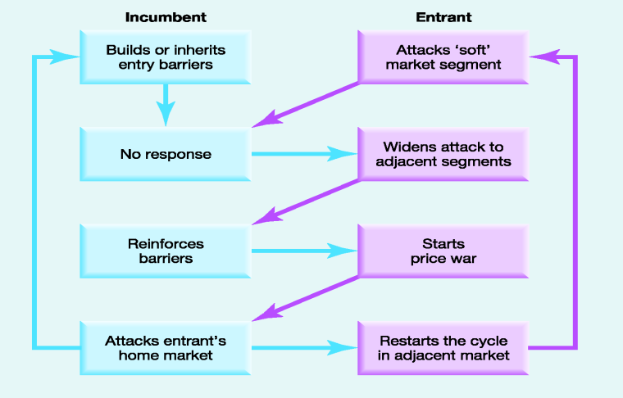
Ciklus konkurentnosti (proces konkurentnosti kroz vrijeme, erozija konkurencije)

Slide 92
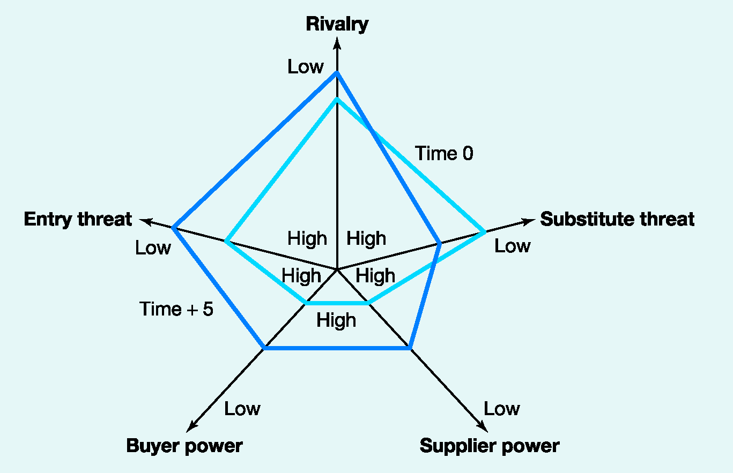
Exhibit 2.5 Comparative Industry Structure Analysis

Slide 93
Hiperkonkurencija?
Hiperkonkurencija se javlja u prisustvu velike frenkventnosti, agresivnosti i velike dinamičnosti konkurenata što dovodi do bržeg kreiranja uslova konstatnog ekvilibrija i promjena.
Notes:
A situation in which there are many very strong competition between companies, markets are changing very quickly..., easy to enter a new market, so that it is not possible for one company to keep a competitive advantage for a long time

Slide 94
Primjer: Microsoft Corporation
Dugo smatran bez konkurencije – kontrola tržišta za PC..
Ali dolazi do erozije konkurentnosti:
  proizvođači čipova direktno ugrađuju softver u poluprovodničke čipove (nema potrebe za odvojenim operativnim softverom)
  niske cijene, ‘glupi’ terminal poput uređaja koji se direktno kače na Internet i koriste prednosti softvera kao što su Sun Microsystems 'Java.
  sistem za prepoznavanje glasa, koje nude telekomunikacijske kompanije, zaobilaze potrebu za trenutnim operativnim sistemima

Slide 95
Konkurencija i tržište
Industrija ili sektor mogu da budu suviše generalni za razumijevanje konkurentnosti
Analiza unutrašnjih slojeva
  Strategijske grupe
    Tržišna segmentacija
    ....

Slide 96
Šta su strategijske grupe?
SG su organizacije u okviru industrije sa sličnim starategijskim karakteristikama, u pogledu starategijskog planiranja čija se strategija konkurentnosti bazira na sličnim principima.

Slide 97
Karakteristike SG
Okvir djelatnosti
Nivo diverzifikacije proizvoda
Geografska pokrivenost
Broj ciljnih grupa
Kanali distribucije
Resursi
Nivo brendiranja
Marketing aktivnosti
Nivoi vertikalne integrisanosti
Kvaliteta proizvoda
Liderstvo u tehnologiji
Organizacija i njen obim

Slide 98
Razlog za identifikaciju SG
Razumijevanje konkurencije
Analiza strategijskih mogućnosti
Analiza mobilnosti barijera
Notes:
Use of Strategic Group Analysis This analysis is useful in several ways:
Helps identify who the most direct competitors are and on what basis they compete.
Raises the question of how likely or possible it is for another organization to move from one strategic group to another.
Strategic Group mapping might also be used to identify opportunities.
Can also help identify strategic problems.

Slide 99
Example: Mapping strategic groups
http://www.daimler.com/company
Broad
GLOBAL, BROAD-LINE
PRODUCERS
e.g., GM, Ford, Toyota, Nissan, Honda, VW, Daimler Chrysler
REGIONALLY-FOCUSED BROAD-LINE PRODUCERS
e.g. Fiat, PSA, Renault,
GLOBAL SUPPLIERS OF NARROW MODEL RANGE e.g., Volvo, Subaru, Isuzu, Suzuki, Saab, Hyundai
PRODUCT
RANGE
NATIONALLY FOCUSED, INTERMEDIATE LINE PRODUCERS
e.g. Tofas, Kia, Proton, Maruti
http://www.marutisuzuki.com/
LUXURY CAR MANUFACTURERS
e.g., Jaguar, Rolls Royce, BMW
NATIONALLY- FOCUSED, SMALL, SPECIALIST PRODUCERS e.g., Bristol (U.K.), Classic Roadsters (U.S.), Morgan (U.K.)
PERFORMANCE CAR PRODUCERS e.g., Porsche, Maserati, Lotus
Narrow
National
GEOGRAPHICAL SCOPE
Global
Notes:
3

Slide 100
Industry group attractiveness
Low entry and mobility barriers
Suppliers and buyers have strong positions
Unattractive industry/groups
High entry and mobility barriers
Strong threats from substitute products
Suppliers and buyers have weak positions
Intense rivalry among competitors
Attractive industry/groups
Few threats from substitute products
Moderate rivalry among competitors
Notes:
Michael Porter (1980) developed the concept and applied it within his overall system of strategic analysis. He explained strategic groups in terms of what he called "mobility barriers". These are similar to the entry barriers that exist in industries, except they apply to groups within an industry. Because of these mobility barriers a company can get drawn into one strategic group or another. Strategic groups are not to be confused with Porter's generic strategies which are internal strategies and do not reflect the diversity of strategic styles within an industry.
Originally, the analysis of intra-industry variations in the competitive behaviour and performance of firms was based primarily on the use of secondary financial and accounting data. The study of strategic groups from a cognitive perspective, however, has gained prominence during the past years (Hodgkinson 1997).
Mobility barriers refer to barriers to movement from one strategic group of firms within an industry to another group.

Slide 101
Šta je tržišni segment (ciljna grupa-CG)?
CG je grupa potrošača sa sličnim osobinama/potrebama koje se razlikuju od osobina /potreba drugih potrošača na tom tržištu.

Slide 102
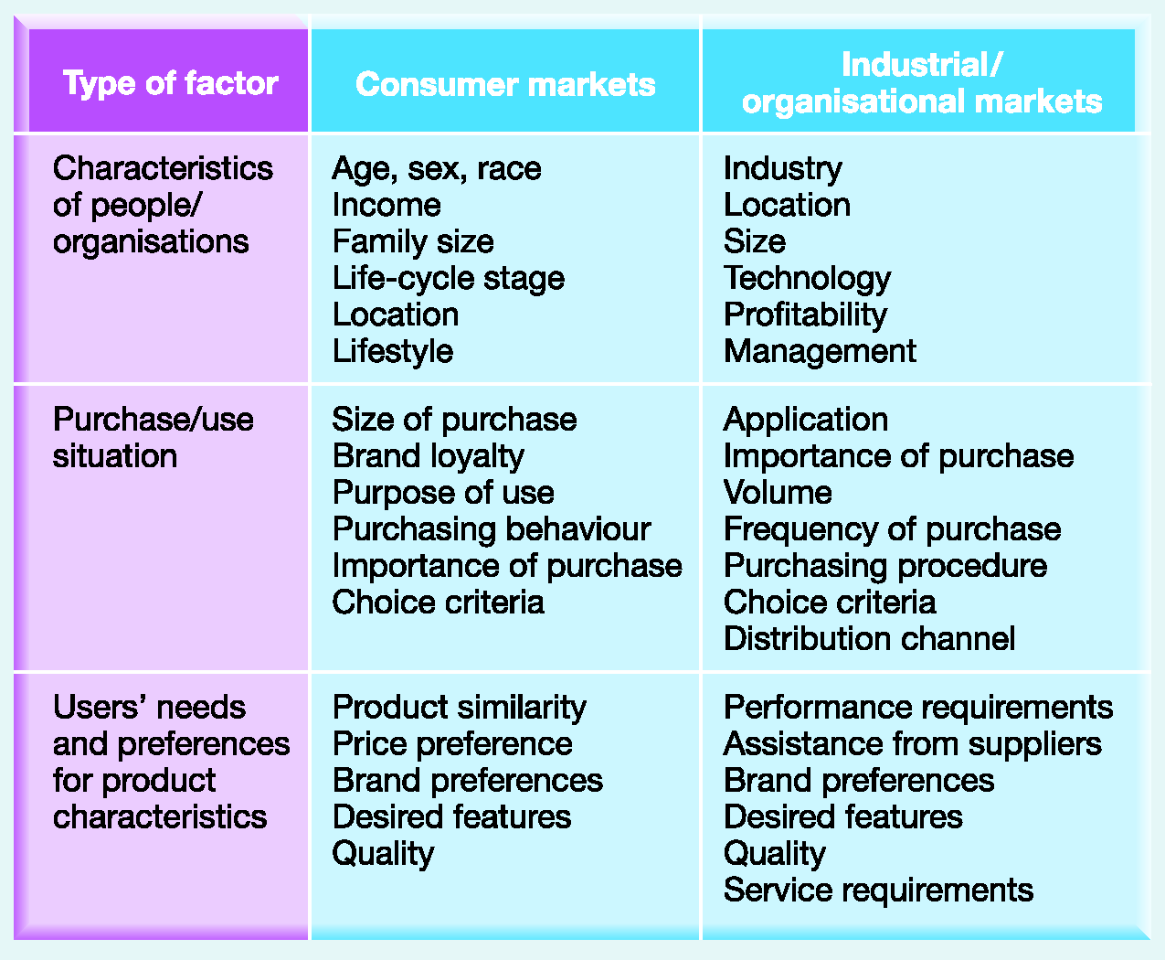
Exhibit 2.7 Some Bases of
Market Segmentation

Slide 103
Ključna pitanja segmentacije
Kako se potrebe potrošača razlikuju od tržišta do tržišta?
Relativne razlike učešća na tržištu (market share) u okviru ciljnih grupa?
Kako se mogu identifikovati ciljne grupe i “uslužiti”?

Slide 104
American Express
Based on Income and age - 9 segments
Up and Comers - <50, >$40k
Affluent established - > 50, > $40k
Affluent Retired - retired, > $40k
Successful Beginners - <35 $15-40k
Mainstream Family 36-50 $15-40k
Conservative Core >50
Young Survivors
Older Survivors
Retired Survivors

Slide 105
Food Products
(bazirano na ličnim stavovima prema hrani )
Hedonists (20%)
  want good life, taste, convenience, not expensive, not health conscious, young, no kids
Don’t Wants (20%)
  Avoid sugar, fat; Are over 50 years, better educated
Weight Conscious (33%)
Moderates (25%)

Slide 106
Levi Strauss Men’s Clothing
Practical Jeans Customer (26%)
    Loyalist, work and play, does not care for style
Trendy/Casual (19%)
    High fashion, likes to be noticed, younger
Price shopper (12%)
    Older, department store sales and discount stores
Mainstream Traditionalist (22%)
    Older, conservative tastes, shops with wife, department stores
Classic Independent (21%)
    late 20s/30s, real spender on clothes, shops alone, specialty stores, traditional styles

Slide 107
Strategijski potrošač?
SP je osoba koja se uvijek identifikuje u strategiji iz razloga s njenog uticaja na aktivnosti nabavke proizvoda i usluga.

Slide 108
Kritični faktori uspjeha
KFU su one karakteristike proizvoda sa kojima organizacija postiže konkurensku prednost iz razloga što takvi proizvodi imaju veću potražnju od strane potrošačkih grupa.

Slide 109
Ključni faktori uspjeha, šta potrošači cijene?
Reputacija
....
....
....

Slide 110
Sažetak (1)
Uticaj poslovnog okruženja se može razumjeti kao slojevi oko jeden org.
Za analizu makro-okruženja se može koristiti kocept PESTEL faktori
Za analizu Industrije i sektora najčešće se koristi Porterov model Pet Snaga (Five Forces model)

Slide 111
Sažetak (2)
Promjene u industriji se mogu analizirati u kontekstu njenog životnog vijeka ili ciklusa, modelom hiperkonkurentnosti, i pomoću radarske mreže pet snaga
Unutrašnji slojevi se mogu analizirati putem analize stratgeijskih grupa, tržišna segmentacija, i strategijsko “platno”.

Slide 112
Ključna debata: kolika je važnost industije? (1)
Dali strageije treba da bude fokusirana na interno ili vanjsko okruženje
Porterov doprinos predlaže da faktori industrije imaju veći uticaj na profitabilnost nego faktori koji se odnose na samu firmu.
ali, ovo varira od jedne do druge industrije

Slide 113
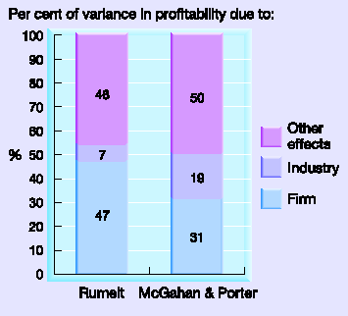
Ključna debata: kolika je važnost industije? (2)

Slide 114
Ključna debata: kolika je važnost industije? (3)
Porterovo i McGahanovo istraživanje predlaže da neke industrije imaju velći uticaj na profitabilnost firme od drugih.
zašto možda neke industrije imaju veliki uticaj na profitabilnost firmi od drugih?

Slide 115
Case Example: The European
Brewing Industry (1)
Complete a PESTEL analysis of the European brewing industry.
Complete a five forces analysis for the industry.
http://www.ab-inbev.com/

Slide 116
Case Example: The European
Brewing Industry (2)
How will the environment affect these companies?
What are the relative strengths and weaknesses of each?

